Slide 1
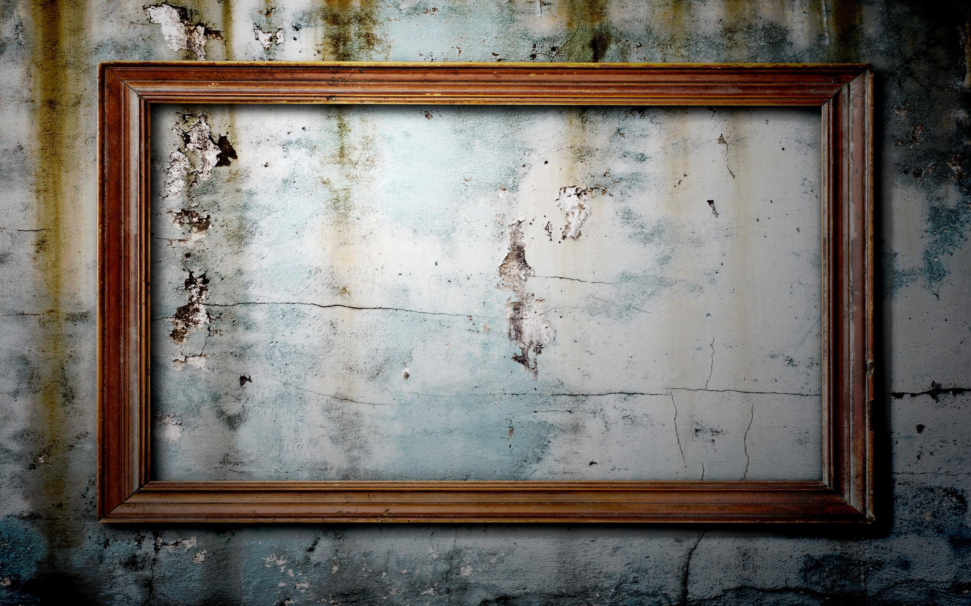

Museum of Modern Art
An Interactive Art Exhibit
Press Here to Begin
By: Faris Kurtagic

Slide 2

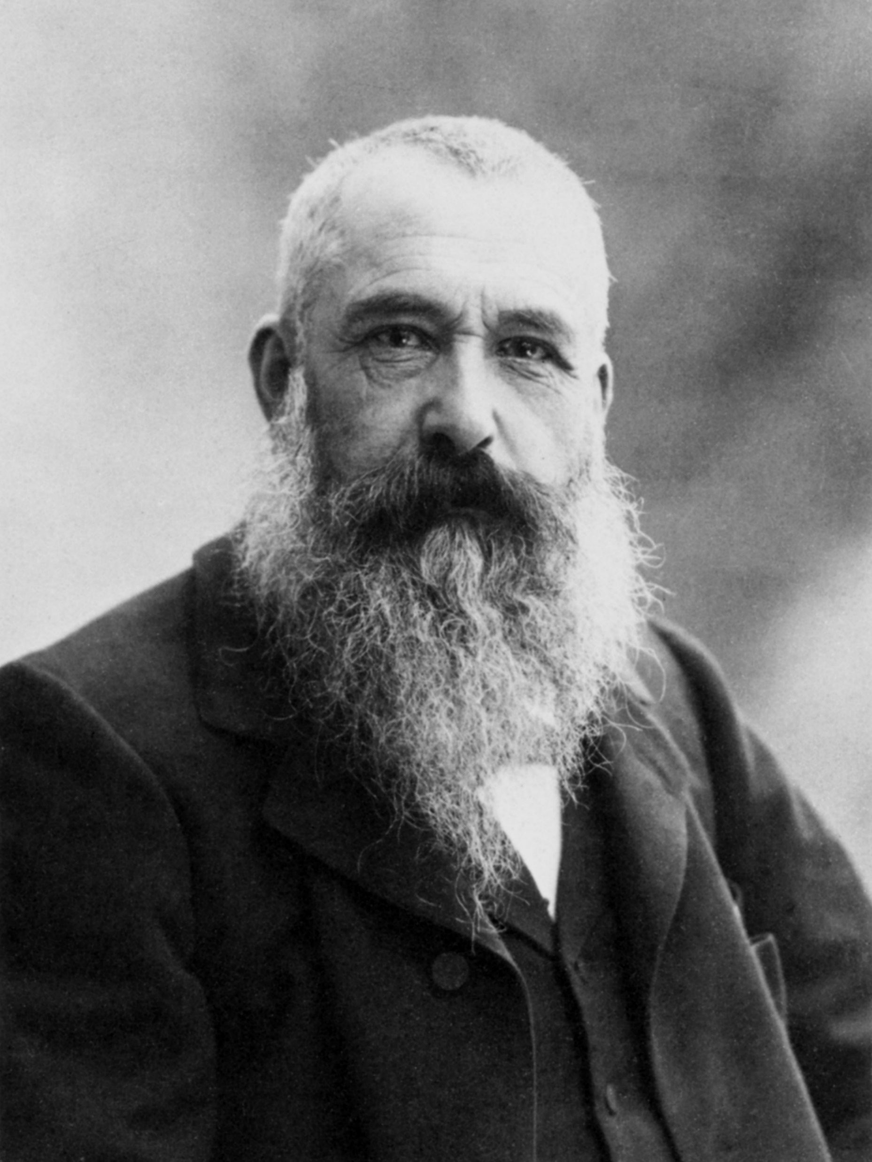
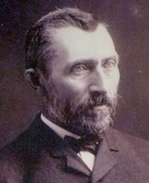
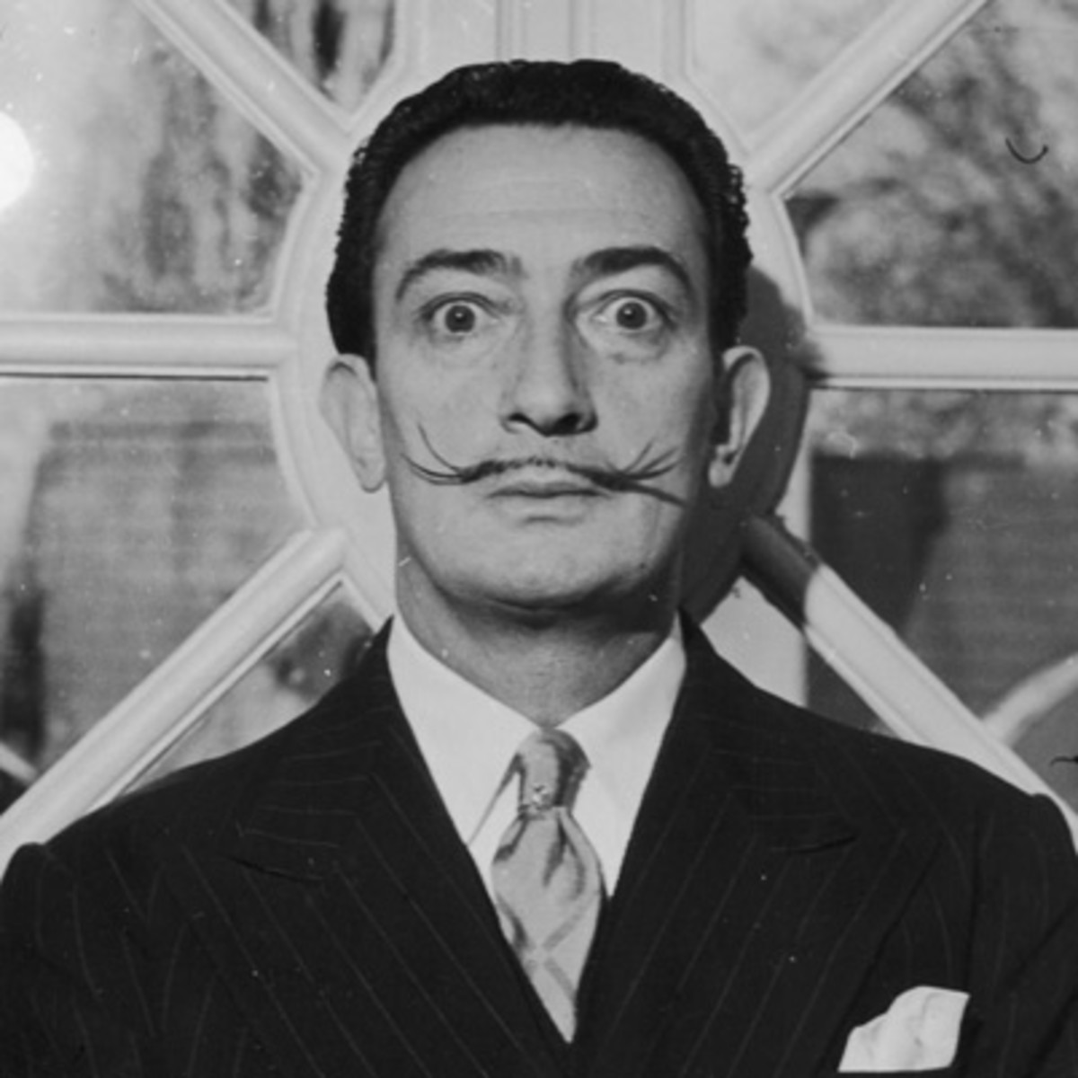
Artists
Claude Monet
Vincent Van Gogh
Salvador Dali
l

Slide 3
Claude Monet
He was a successful caricaturist in his native Le Havre, but after studying plein-air landscape painting, he moved to Paris in 1859. He soon met future Impressionists Camille Pissarro and Pierre-Auguste Renoir. Renoir and Monet began painting outdoors together in the late 1860s, laying the foundations of Impressionism. In 1874, with Pissarro and Edgar Degas, Monet helped organize the Société Anonyme des Artistes, Peintres, Sculpteurs, Graveurs, etc., the formal name of the Impressionists' group. During the 1870s Monet developed his charateristic technique for rendering atmospheric outdoor light, using broken, rhythmic brushwork. Throughout his career, he remained loyal to the Impressionists' early goal of capturing the transitory effects of nature through direct observation. In 1890 he began creating paintings in series, depicting the same subject under various conditions and at different times of the day. His late pictures, made when he was half-blind, are shimmering pools of color almost totally devoid of form.
Paintings
Water Lillies
Agapanthus
The Japanese Footbridge

Slide 4
Vincent Van Gogh
Except for some brief periods of formal instruction, van Gogh was self-taught; he collected prints and reproductions to study and copy, especially those of Millet. His life and work are legendary in the history of art, making him the quintessential misunderstood, tormented, even insane artist, who sold only one work in his lifetime but whose paintings achieved record auction sales prices after his death. Van Gogh was active as an artist for only ten years, during which time he produced around 1000 watercolors, drawings and sketches and nearly 1250 paintings. His styles included an early dark, Realist style and a later colorful, intense, expressionistic style. Almost more than on his oeuvre, his fame has been based on the extensive, diary-like correspondence he maintained, in particular with his brother, Theo.
Paintings
The Starry Night
The Olive Trees
Portrait of Joseph Roulin

Slide 5
Salvador Dali
Dalí’s chief theoretical contribution to Surrealism was his elaboration, in the early 1930s, of the “paranoiac-critical method”—a process, he wrote, to “systematize confusion and thereby contribute to a total discrediting of the world of reality.” 1 The method described a deliberately disoriented state of mind that would allow an individual to connect unrelated things, forging fresh avenues of thought and creation. Around the same time, he also published several essays naming and defining the so-called “Surrealist object”: an object “functioning symbolically,” 2 usually constructed from found items or readymade materials, and redolent with psychological power. His Retrospective Bust of a Woman was one such object. Beneath its seemingly haphazardly embellished portrait bust of a woman pulsed a rich network of associations, from references to consumption (corn cobs and a baguette) to putrefaction (an ant swarm, a recurrent motif in Dalí’s work).
Paintings
Illuminated Pleasures
The Persistence of Memory
Frontispiece for Second Surrealist Manifesto

Slide 6
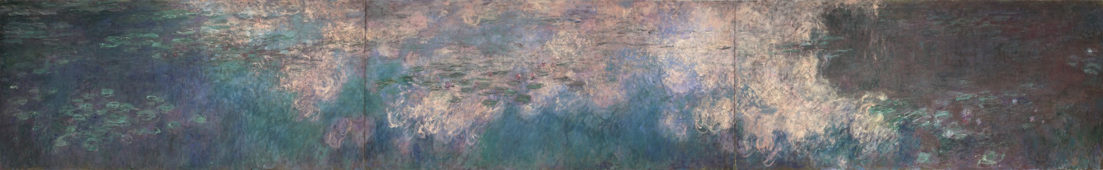
Water Lillies (1914-26)
Claude Monet
About this painting

Slide 7
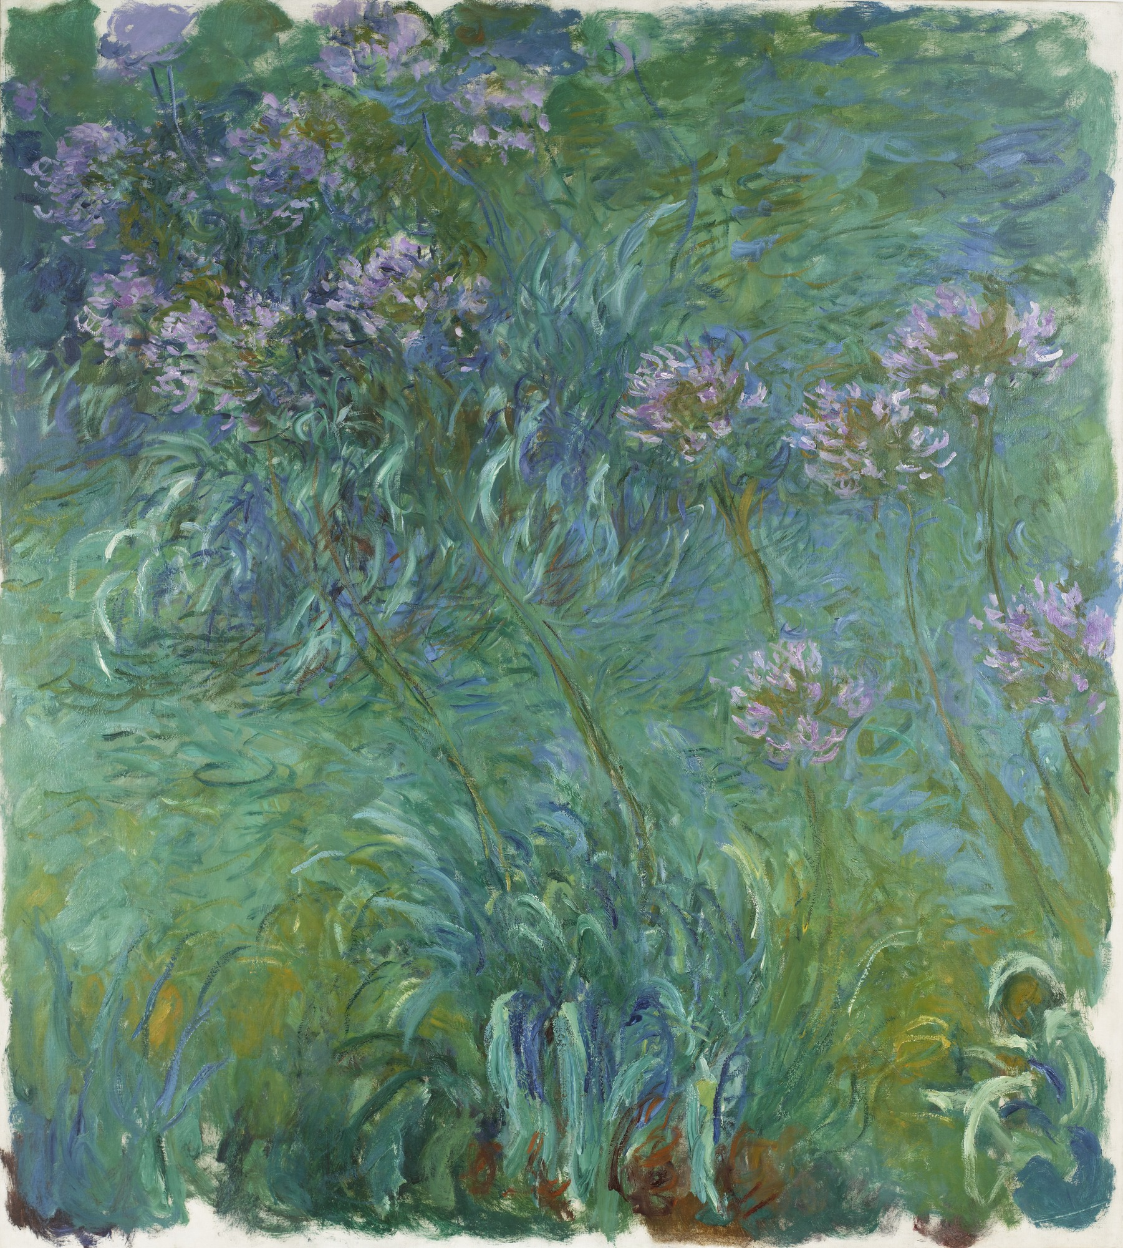
Agapanthus (1914-26)
Claude Monet
About this painting

Slide 8
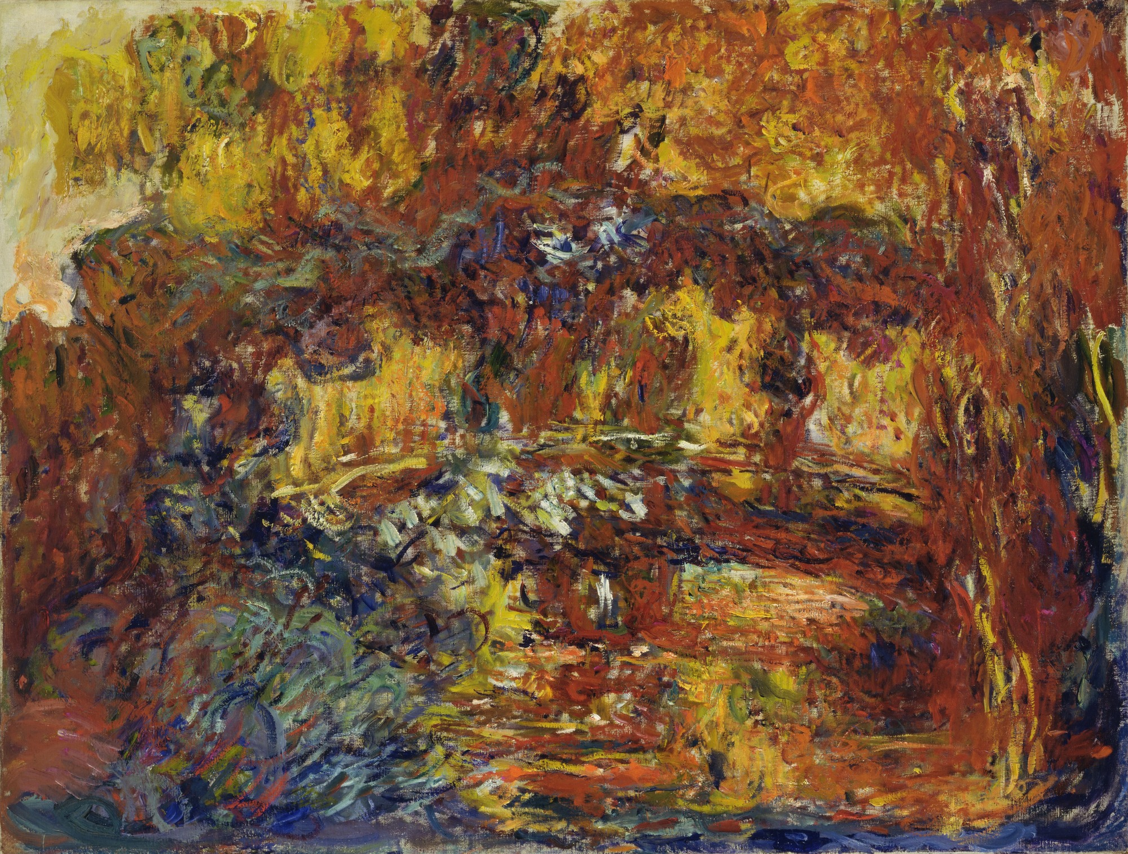
The Japanese Footbridge (1920-22)
Claude Monet
About this painting
About this painting

Slide 9
Claude Monet Water Lilies 1914-26
Claude Monet
In this triptych Monet depicted his Japanese-style pond covered with water lilies, at center, shimmering with reflections of clouds overhead. The water's surface fills the expansive composition so that conventional clues to the artist's—and the viewer's—vantage point are eliminated. Monet wished for the paintings to encompass the viewer: in his designs for the Musée de l'Orangerie in Paris, he specified that the Water Lily canvases be displayed on curved walls.

Slide 10
Claude Monet Agapanthus (1914-26)
Claude Monet
Monet frequently painted outdoors, drawing endless inspiration from the plants, trees, and pond at Giverny. The gardens on his property were the great extravagance of his final years; their upkeep required the services of six full-time gardeners. Monet planted agapanthus—a thin, wispy lily plant native to Africa—along the banks of his pond as well as several other types of indigenous and imported vegetation, such as wisteria, irises, and bamboo.

Slide 11
Claude Monet The Japanese Footbridge (1920-22)
Claude Monet
The Japanese Footbridge is among Monet's last paintings of this subject, made between 1920 and 1922. Twenty-five years earlier, in the late 1890s, the footbridge provided the subject of Monet's first series of paintings of his pond at Giverny. While the paintings in the earlier series are more naturalistic in style, the later works feature dense swirls and loose strokes of color that almost obscure the form of the bridge. These later paintings also feature a fiery palette of maroons, rusts, and oranges unique within Monet's body of work.

Slide 12
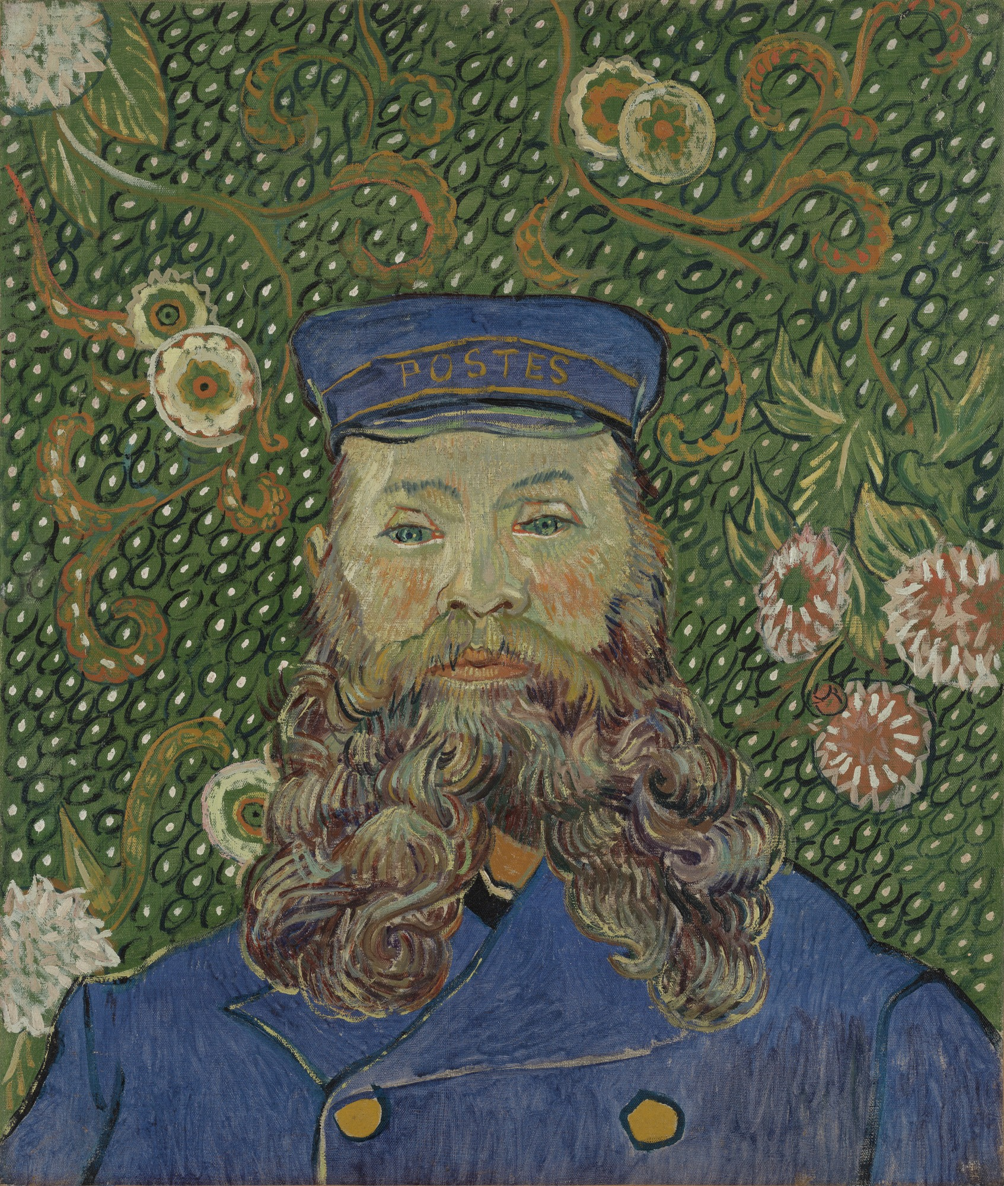
Portrait of Joseph Roulin (1889)
Vincent Van Gogh
About this painting

Slide 13
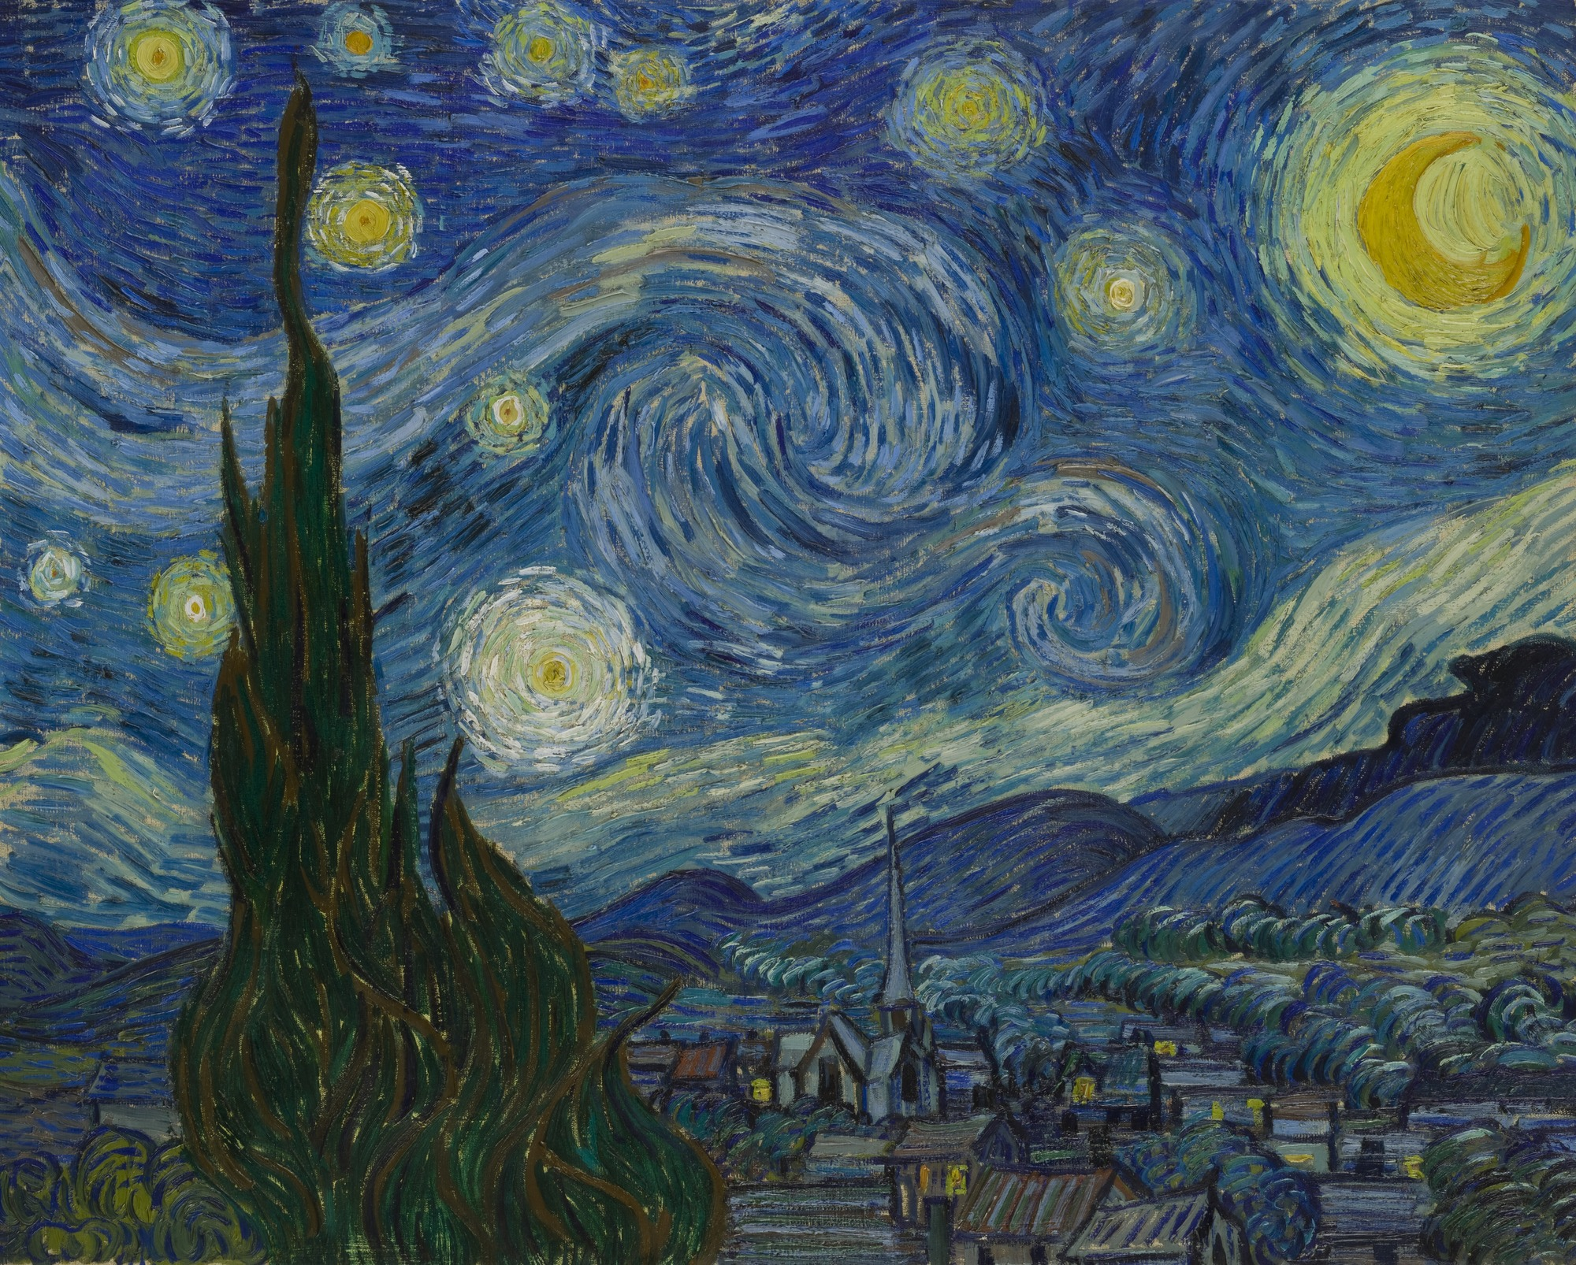
The Starry Night (1889)
Vincent Van Gogh
About this painting

Slide 14
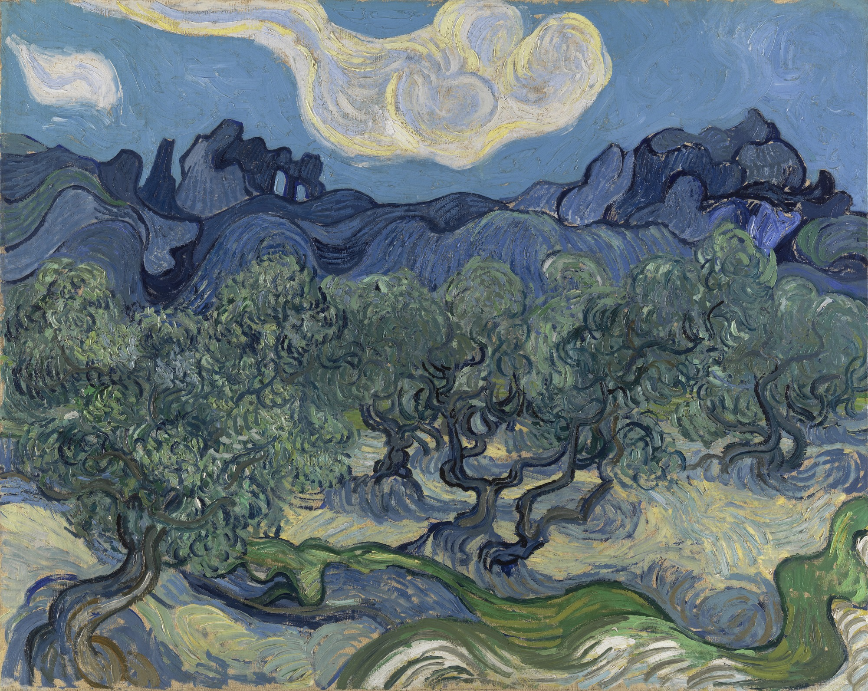
The Olive Trees (1889)
Vincent Van Gogh
About this painting

Slide 15
Vincent Van Gogh Portrait of Joseph Roulin (1889)
Vincent Van Gogh
This portrait of Joseph Roulin is one of six van Gogh painted of his close friend, a postal employee in the southern French town of Arles, a fifteen-hour train ride from Paris. Van Gogh had moved to Arles in 1888, hoping to create an artists cooperative there. The plan never came to fruition, and the artist became lonely and isolated. He found comfort and companionship with the Roulin family, and they are the subjects of many of his paintings. In this portrait, Roulin is depicted in the uniform he always wore proudly, set against an imaginative backdrop of swirling flowers. In a letter to his brother Theo, the artist wrote that, of all genres, "the modern portrait" excited him the most: "I want to paint men and women with that something of the eternal which the halo used to symbolize, and which we try to convey by the actual radiance and vibration of our coloring."

Slide 16
Vincent Van Gogh The Starry Night (1889)
Vincent Van Gogh
"This morning I saw the country from my window a long time before sunrise, with nothing but the morning star, which looked very big," van Gogh wrote to his brother Theo, from France. Rooted in imagination and memory, The Starry Night embodies an inner, subjective expression of van Gogh's response to nature. In thick, sweeping brushstrokes, a flamelike cypress unites the churning sky and the quiet village below. The village was partly invented, and the church spire evokes van Gogh's native land, the Netherlands.

Slide 17
Vincent Van Gogh The Olive Trees (1889)
Vincent Van Gogh
After van Gogh voluntarily entered the asylum at Saint-Rémy in the south of France in the spring of 1889, he wrote his brother Theo: "I did a landscape with olive trees and also a new study of a starry sky." Later, when the pictures had dried, he sent both of them to Theo in Paris, noting: "The olive trees with the white cloud and the mountains behind, as well as the rise of the moon and the night effect, are exaggerations from the point of view of the general arrangement; the outlines are accentuated as in some old woodcuts."

Slide 18
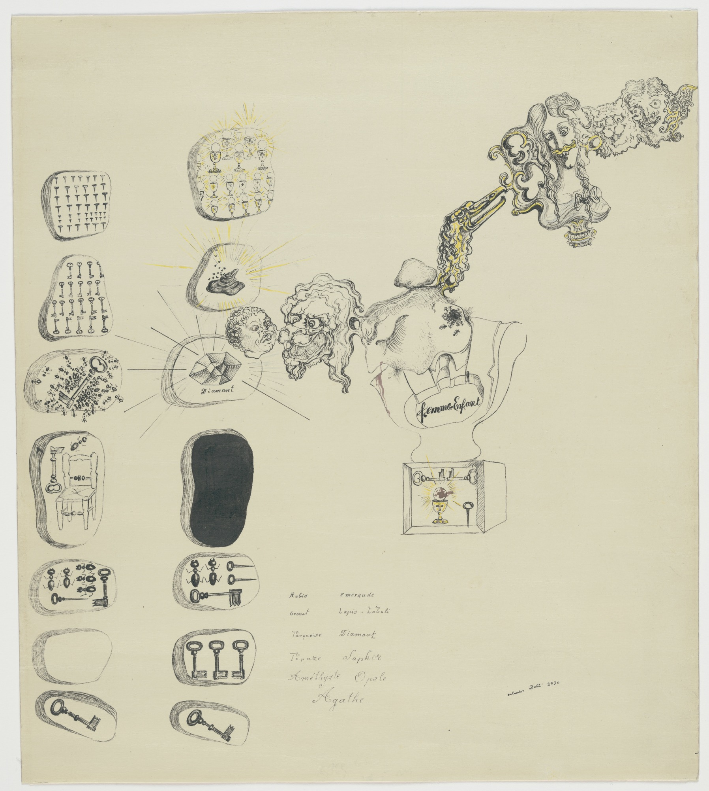
Frontispiece for Second Surrealist Manifesto (1930)
Salvador Dali
About this painting

Slide 19
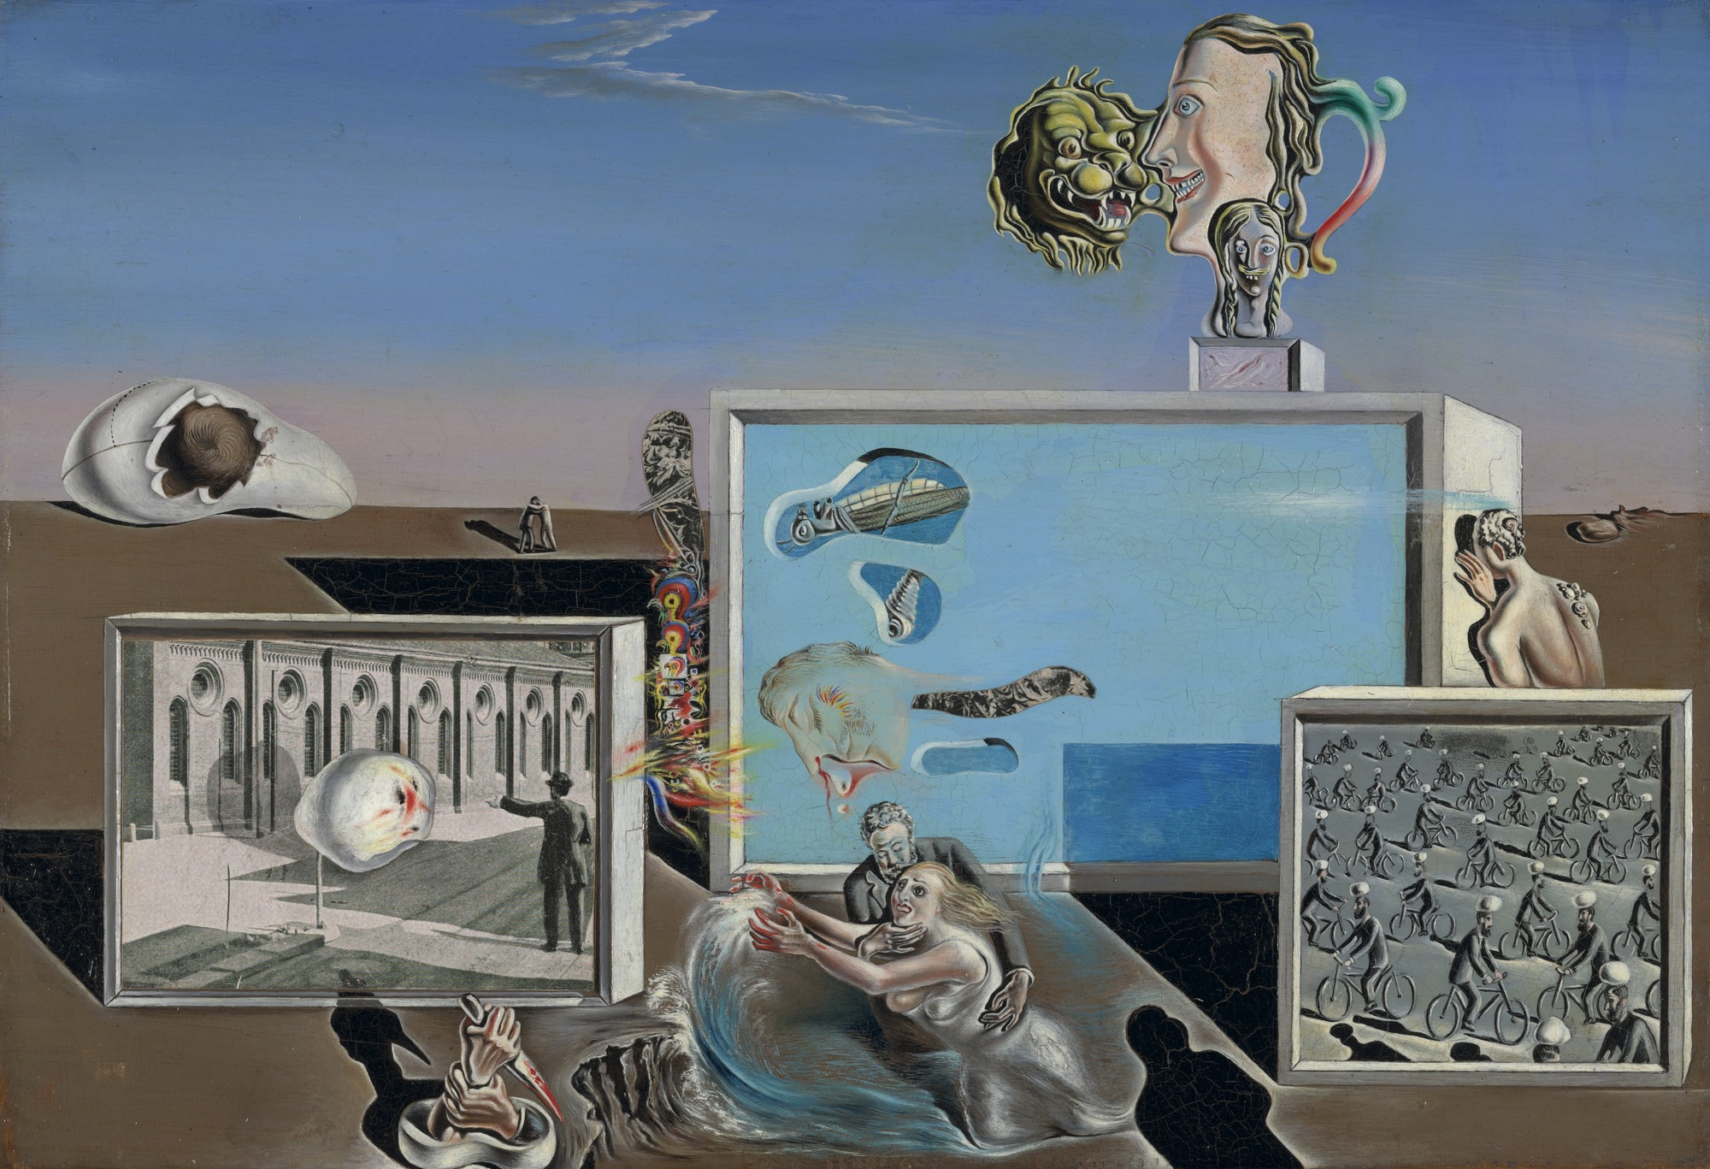
Illumined Pleasures (1929)
Salvador Dali
About this painting

Slide 20
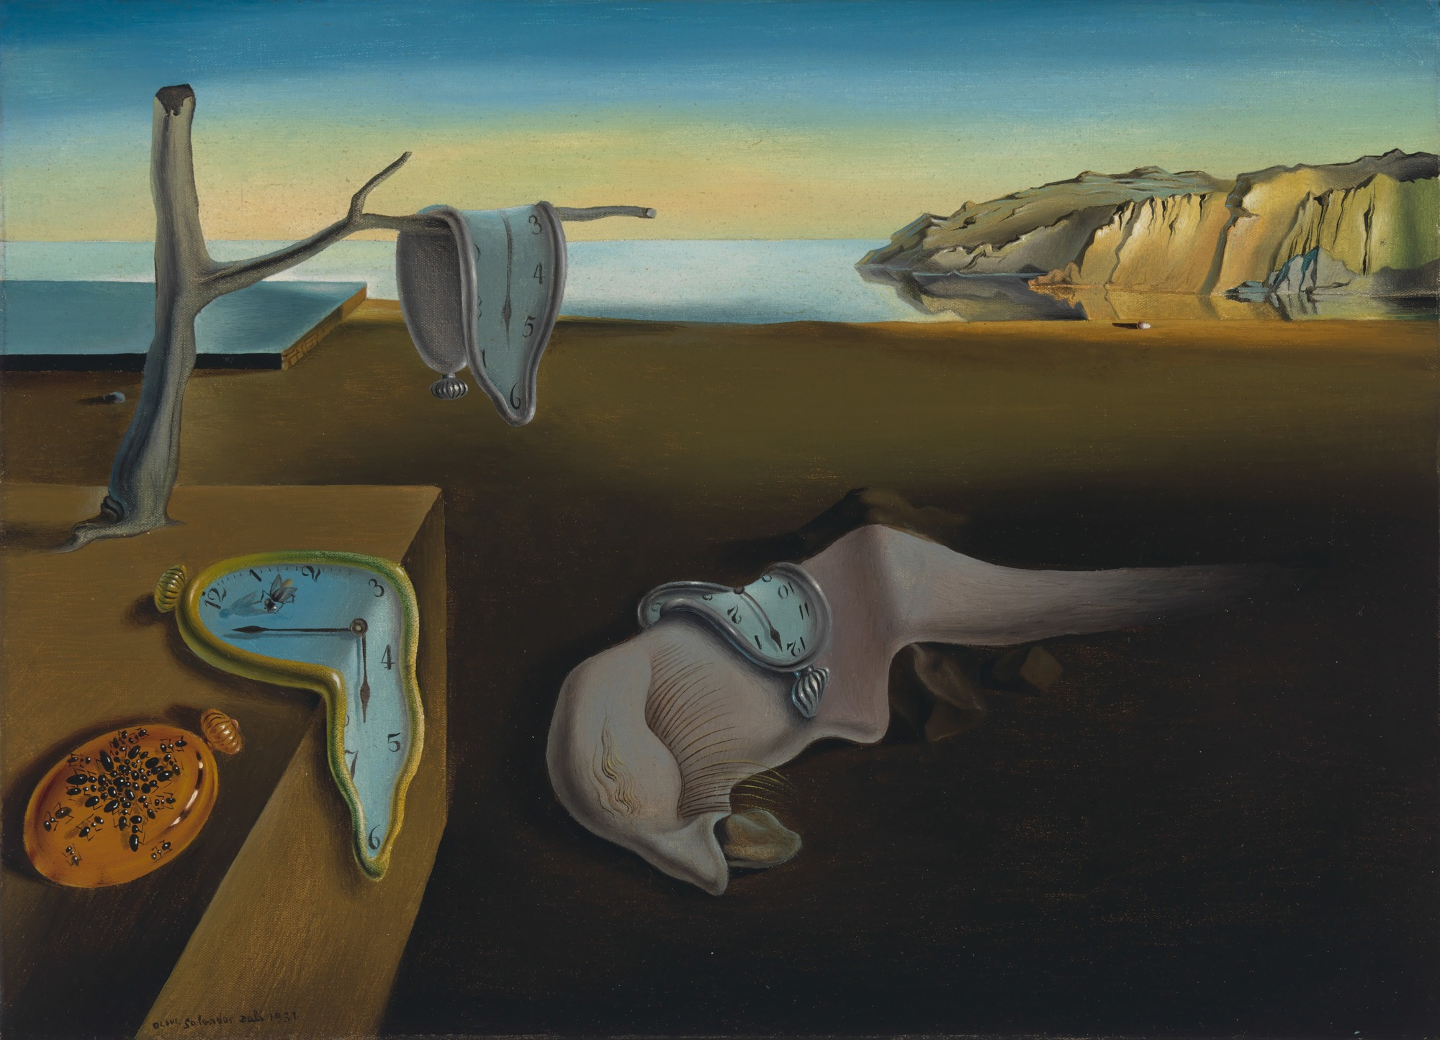
The Persistence of Memory (1931)
Salvador Dali
About this painting

Slide 21
Salvador Dalí Frontispiece for Second Surrealist Manifesto (1930)
Salvador Dali
Dalí had recently joined the Surrealist movement when he executed this drawing, which served as the frontispiece for the "Second Surrealist Manifesto" when it was published in a limited edition of sixty copies in 1930. The composition's upper-right quadrant is dominated by an anthropomorphic chain of flesh, in which a human head turns into a lion, which becomes a misshapen,ant-infested profile. The succession continues with a bird's head, a mustachioed female bust, anothe male profile, and two more frontal faces, one animal and one human. These fantastic characters stretch out in a string of anatomy that might have continued endlessly were it not for the edge of the sheet.

Slide 22
Salvador Dalí Illumined Pleasures (1929)
Salvador Dali
The title of this work may refer to the luminous imagery projected on or performed within the theater-like boxes that dominate the composition. Here Dalí played with the disjunctions between reality and the illusion experienced in the darkness of a movie theater. The imagery, realized through a combination of painting and collage, refers to personal and universal dreams and anxieties. Dalí's own disembodied head appears in the middle box, while an allegory of castration anxiety plays out below. Underscoring the experience of motion–picture viewing presented in the painting, this work illustrated the shooting script for Un Chien andalou when it was published in the journal La Révolution surréaliste.

Slide 23
Salvador Dalí The Persistence of Memory (1931)
Salvador Dali
Dalí rendered his fantastic visions with meticulous verisimilitude, giving the representations of dreams a tangible and credible appearance. In what he called "hand painted dream photographs," hard objects become inexplicably limp, time bends, and metal attracts ants like rotting flesh. The monstrous creature draped across the painting's center resembles the artist's own face in profile; its long eyelashes seem insectlike or even sexual, as does what may or may not be a tongue oozing from its nose like a fat snail.

Slide 24

References
Claude Monet
https://www.onthisday.com/people/claude-monet
https://www.moma.org/artists/4058?locale=en
https://www.moma.org/collection/works/80220?artist_id=4058&locale=en&page=1&sov_referrer=artist
https://www.moma.org/collection/works/79254?artist_id=4058&locale=en&page=1&sov_referrer=artist
https://www.moma.org/collection/works/79922?artist_id=4058&locale=en&page=1&sov_referrer=artist
Vincent Van Gogh
https://www.onthisday.com/people/vincent-van-gogh
https://www.moma.org/artists/2206?locale=en
https://www.moma.org/collection/works/79802?artist_id=2206&locale=en&page=1&sov_referrer=artist
https://www.moma.org/collection/works/79105?artist_id=2206&locale=en&page=1&sov_referrer=artist
https://www.moma.org/collection/works/80013?artist_id=2206&locale=en&page=1&sov_referrer=artist
Salvador Dali
https://www.biography.com/people/salvador-dal-40389
https://www.moma.org/artists/1364?locale=en
https://www.moma.org/collection/works/80021?artist_id=1364&locale=en&page=1&sov_referrer=artist
https://www.moma.org/collection/works/37430?artist_id=1364&locale=en&page=1&sov_referrer=artist
https://www.moma.org/collection/works/79018?artist_id=1364&locale=en&page=1&sov_referrer=artist

